Slide 1

A Novel Application of Computer Vision and Machine Learning for Three-Dimensional Reconstruction of Lung Anatomy and Pathology
Done By: Bardh Rushiti
Mentored By: Dr. Thomas Kinsman
RIT, 2023

Slide 2
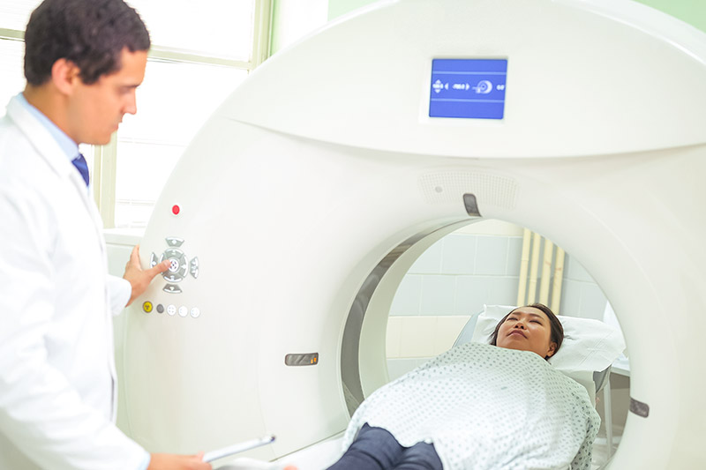
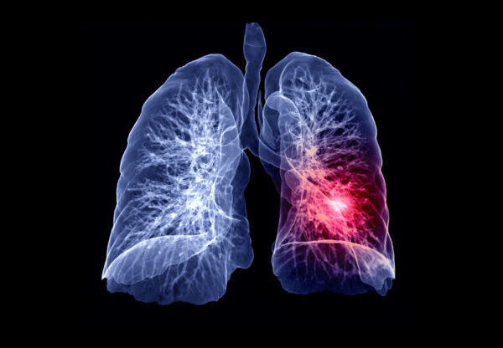
Overview
Utilize advanced computer vision and machine learning techniques for 3D reconstruction of lungs, airways, and potential lung nodules.

Slide 3
Overview
Nodule Detection, Segmentation, and 3D Reconstruction
Airways Segmentation and 3D Reconstruction
Lung Segmentation and 3D Reconstruction

Slide 4
Motivation
Early detection is crucial for improving patient outcomes in lung cancer
Current methods are manual and time-consuming, leading to low accuracy and efficiency
Improve preoperative planning and simplify complex procedure by enhancing the surgeon’s knowledge of the patient’s specific anatomy

Slide 5
Objective
To analyze nodule size, shape, location, and proximity to airways for signs of malignancy.
To improve the accuracy and efficiency of lung nodule detection through image pre-processing, feature extraction, and model training and evaluation.
To potentially improve the diagnostic capabilities of oncologists and patient outcomes by providing a more accurate and efficient method for lung nodule detection and lung and airway reconstruction.

Slide 6
Background
Lungs
Airways
Nodules

Slide 7
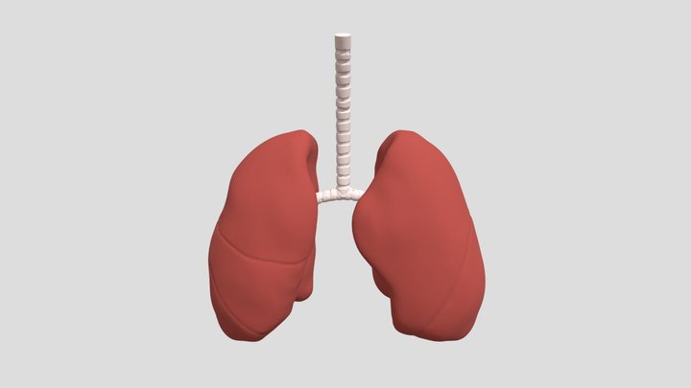
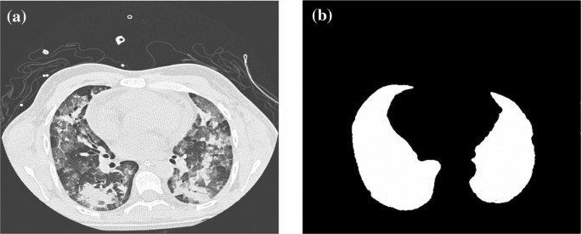
Background
Lungs
[2] segments lungs using classical vision techniques like thresholding, morphological operation, region growing.
[3] segments lungs by using intensity and gradient features.
[4] uses CNN to segment out lungs region from non-lung regions.
[1] constructs the 3D model by using different angular positions of CT scan.
Airways
Nodules

Slide 8
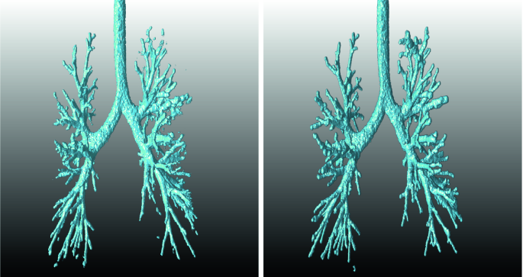
Background
Lungs
[2] segments lungs using classical vision techniques like thresholding, morphological operation, region growing.
[3] segments lungs by using intensity and gradient features.
[4] uses CNN to segment out lungs region from non-lung regions.
[1] constructs the 3D model by using different angular positions of CT scan.
Airways
[5] use a combination of morphological operation and level set methods to 3D reconstruct pulmonary airways.
[6] use a combination of deformable model and region-based active contour model.
[7] uses models the airway trees as graph-based problem.
Nodules

Slide 9
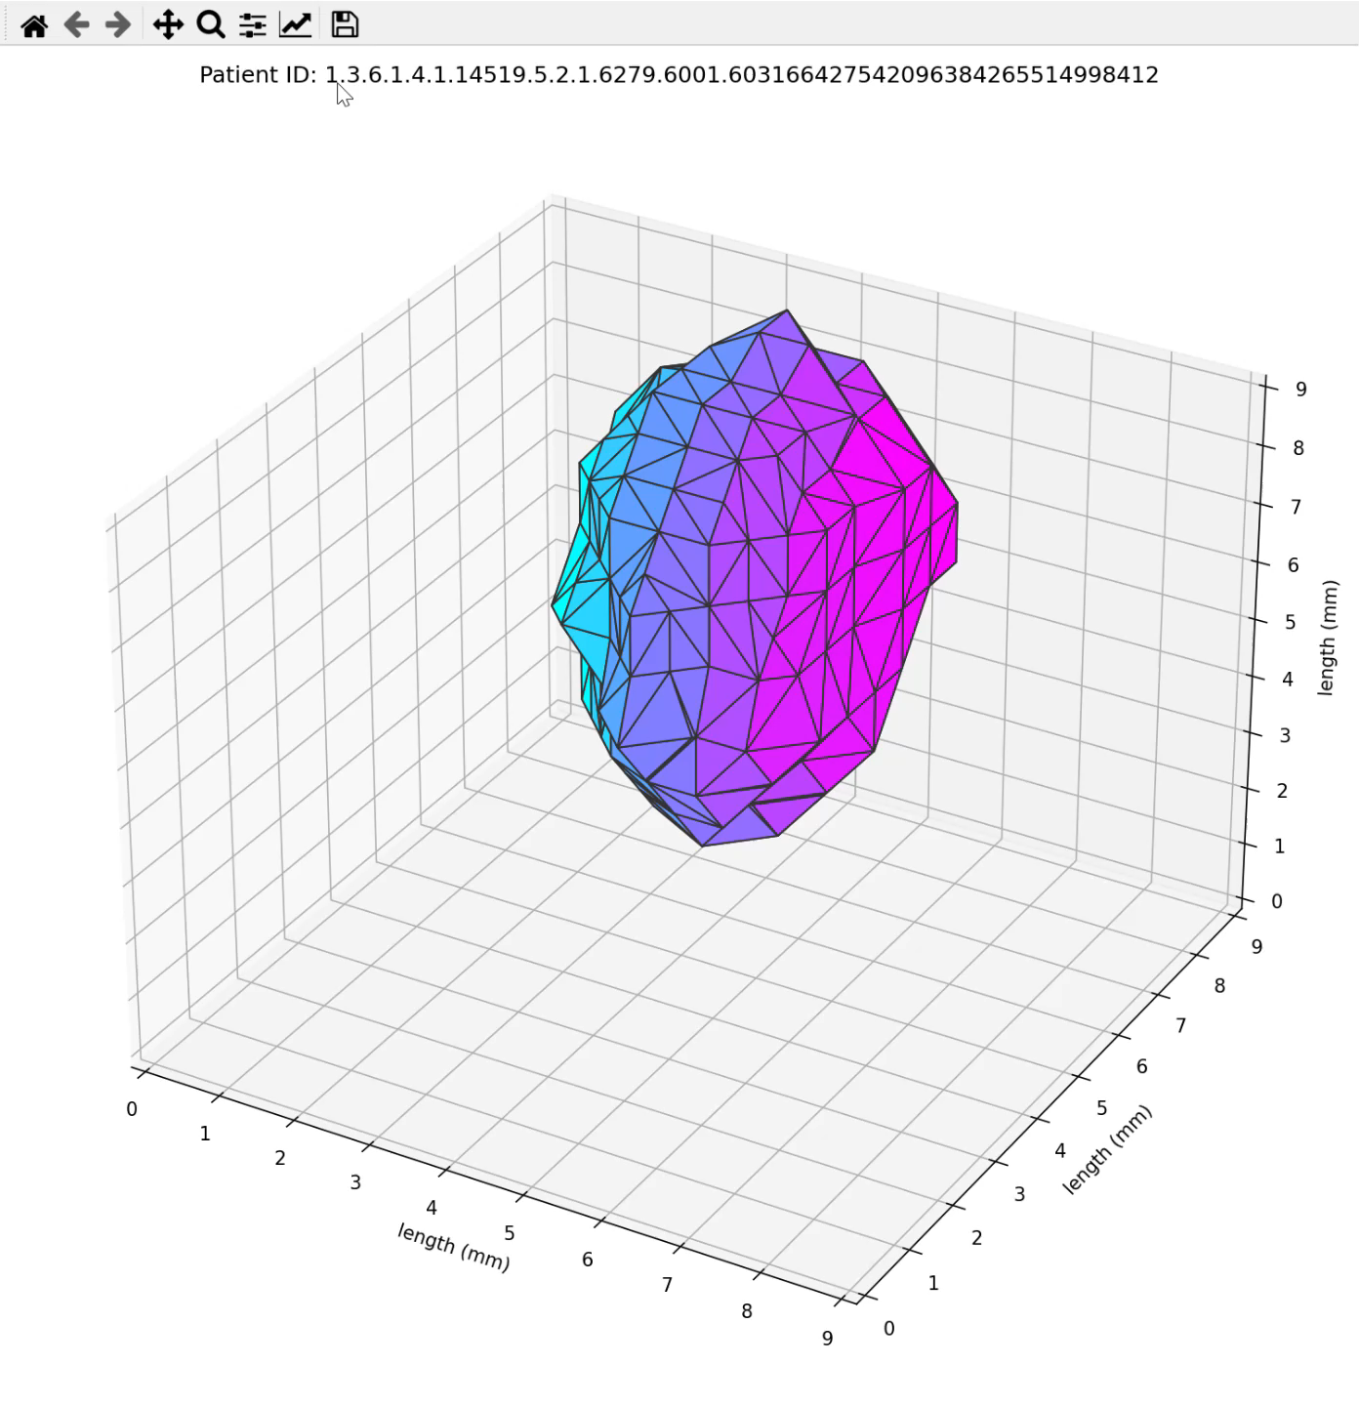
Background
Lungs
[2] segments lungs using classical vision techniques like thresholding, morphological operation, region growing.
[3] segments lungs by using intensity and gradient features.
[4] uses CNN to segment out lungs region from non-lung regions.
[1] constructs the 3D model by using different angular positions of CT scan.
Airways
[5] use a combination of morphological operation and level set methods to 3D reconstruct pulmonary airways.
[6] use a combination of deformable model and region-based active contour model.
[7] uses models the airway trees as graph-based problem.
Nodules
[8] a comparison of several computer-aided detection (CAD) methods for lung nodules on CT scans.
[9] use of deep convolutional neural networks (CNNs) for computer-aided detection and highlights the importance of dataset characteristics and transfer learning for improving performance.
[10] utilizes a 3D CNN multi-task-learning framework for automated pulmonary nodule detection and classification on CT images.

Slide 10
Obstacles of current methods
Low inter-observer (oncolog) agreement for malignant nodule
High rate of false negatives
Long time for manual inspection of CT Scans
Dependence of radiologists’ expertise and subjective interpretation (bias)

Slide 11
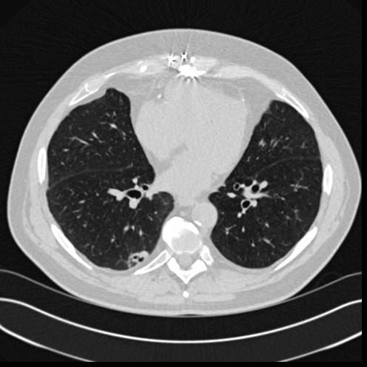
Methodology
Lungs
Image pre-processing with classical vision techniques like contrast enhancement, thresholding, morphological operations, etc.
Region of interest identification for finding the body
Inversion and watershed segmentation
3D Reconstruction
Lung Airways
Lung Nodules
Approach it as an end-to-end multi-task learning problem

Slide 12
Methodology

Slide 13
Methodology – Pulmonary Nodule Detection
[8-10] have shown a multitude of approaches that have shown state-of-the-art performance
Reduced false positives
Highly accurate detection
Highly accurate segmentation
Explore neural network architecture configuration for 3D-CNN and multi-task learning

Slide 14
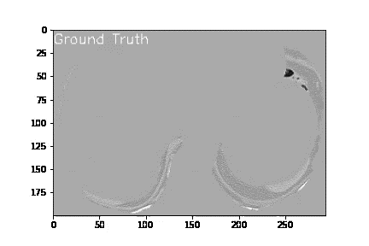
Methodology
Data and Labels - The Lung Image Database Consortium (LIDC)
1018 patients, with > 100GB of labeled data
4 radiologist
> 600 lung nodules
Tools:
Python for visualizations (Matplotlib)
C++ for processing (with API available for Python)
PyTorch for model training and evaluation

Slide 15
Analysis of Nodules Malignancy
Risk of nodule malignancy:
Size
Shape irregularities
Proximity to pulmonary airways
Composition
Notes:
Lung nodules are evaluated by their size, shape/borders and composition.
Size
Small: Less than 6mm
Medium: 6 to 8mm
Large: Greater than 8mm
Shape:
Benign nodules tend to have smooth or round margins (borders or edges). Cancerous nodules often have borders that are uneven, jagged or poorly defined.
Composition:
Calcified nodules contain calcium and are easily seen because they are high in density. Calcium deposits in nodules may occur after a lung infection. These are usually benign.
Non-calcified nodules are often caused by past infection or inflammation. These may appear as either solid or non-solid
Solid: The radiologist may describe it as a “soft tissue density” or “soft tissue attenuation.”
Non-solid:
Ground glass opacity (GGO). GGO is a hazy area of faintly increased density. Think of it as a window with fingerprints in it. You can still see through, but everything is just a little fuzzy. These nodules tend to be benign
Part solid. This type of nodule is a mix of solid density and ground glass density parts.

Slide 16
Milestones:
Milestone 1: Lung Segmentation and 3-Dimensional Reconstruction
Milestone 2: Airways Segmentation and 3-Dimensional Reconstruction
(After break) Milestone 3: Nodule Detection, Segmentation and 3-Dimensional Reconstruction
Milestone 4: Put everything in an interactive visualization program

Slide 17
Thank You!

Slide 18
Useful References
"Three-dimensional pulmonary imaging by computed tomography," by Sundaram et al., Radiology, 1983
"Semi-automated segmentation of lung regions in CT images," by Yan et al., Medical Image Analysis, 2005
"Automated lung segmentation in CT images using a supervised classification approach," by Castillo et al., Medical Image Analysis, 2008
"Pulmonary airway tree extraction and morphometric analysis from CT images," by Henschke et al., Radiology, 2003
"Automatic Segmentation of Airway Tree Structures in CT Images" by Willems et al. (2010)
"A Hybrid Model for Airway Segmentation in CT Images" by Ge et al. (2010)
"Automatic Airway Tree Segmentation using 3D Convolutional Neural Networks" by Shuo Han et al. (2018)
"Computer-aided detection of lung nodules on CT scans: a comparative study" by Armato et al. (2011)
"Deep convolutional neural networks for computer-aided detection: CNN architectures, dataset characteristics and transfer learning" by Zhang et al. (2017)
"NoduleNet: A Deep Learning Framework for Automated Pulmonary Nodule Detection and Classification on CT Images" by Lee et al. (2019)

